Slide 2
FIT 152 Fundamentals of Information Technology
Lecture 2
Information Technology and its related disciplines

Slide 3
FIT 152: Module outcomes
Upon successful completion of this course, the student will be able to:
Demonstrate an understanding of the relationship between IT and related and informing disciplines.
Demonstrate insight in the history of computing technology, and an understanding of the Internet, and the World-Wide Web, as well as the components of an IT system and how they interrelate.
Demonstrate an understanding of complexity in an information technology environment and how and why it occurs.
Demonstrate an understanding of why life-long learning and continued professional development is critical for an IT professional.
Illustrate the use of information and communication technologies to solve problems.
Demonstrate an understanding of how and to what extent IT has changed various application domains.

Slide 4
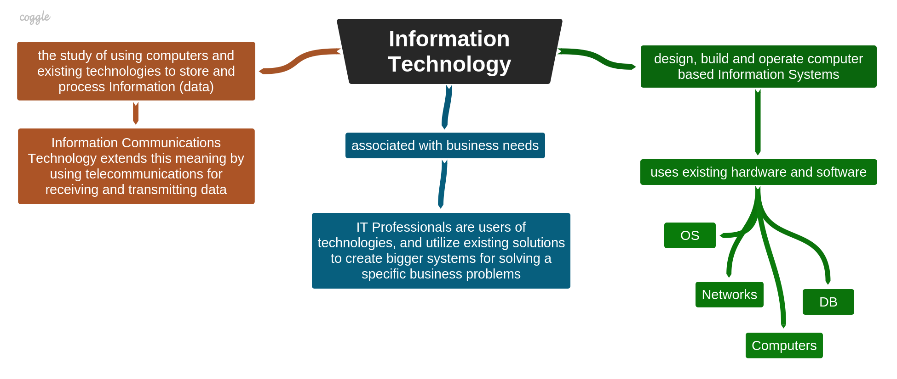
What is Information Technology?

Slide 5
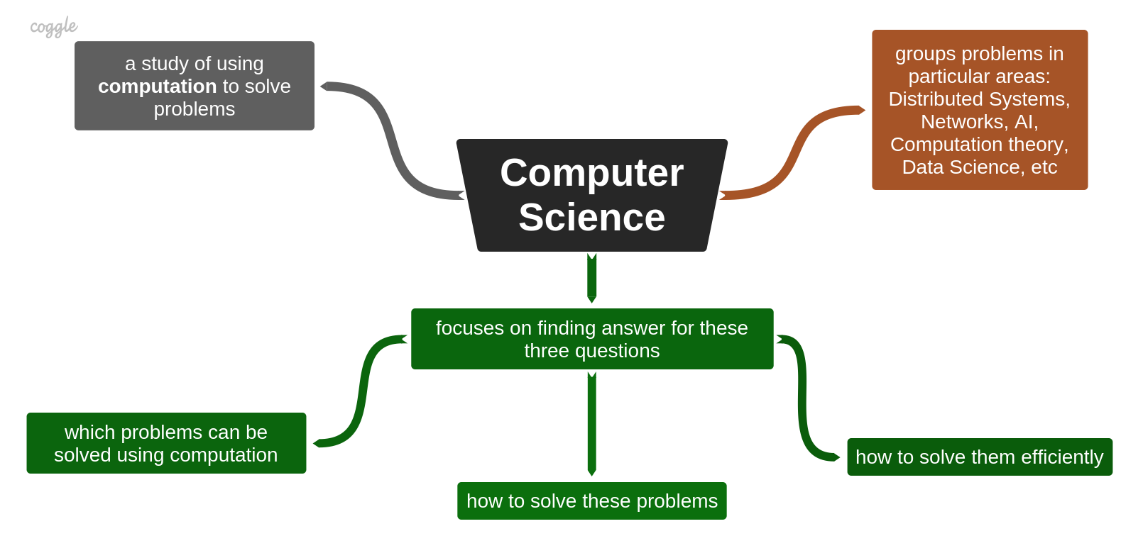
What is Computer Science?

Slide 6
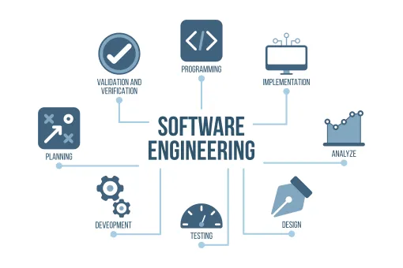
What is Software Engineering?

Slide 7
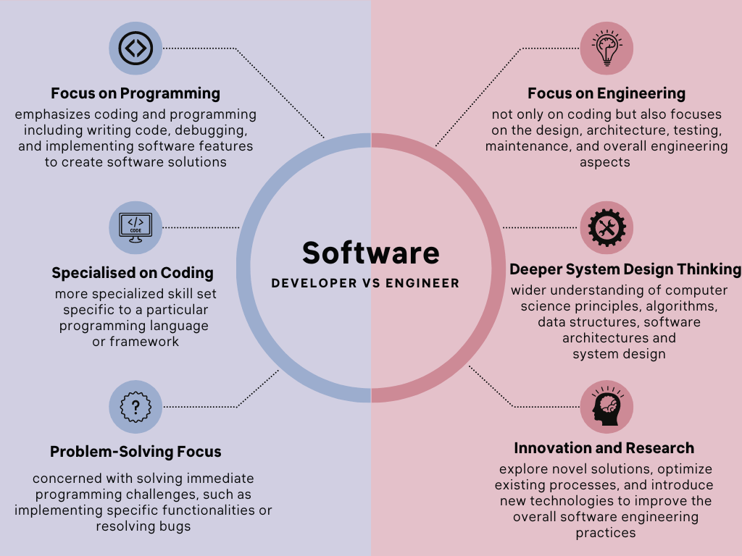
Software Developer vs Software Engineer

Slide 8
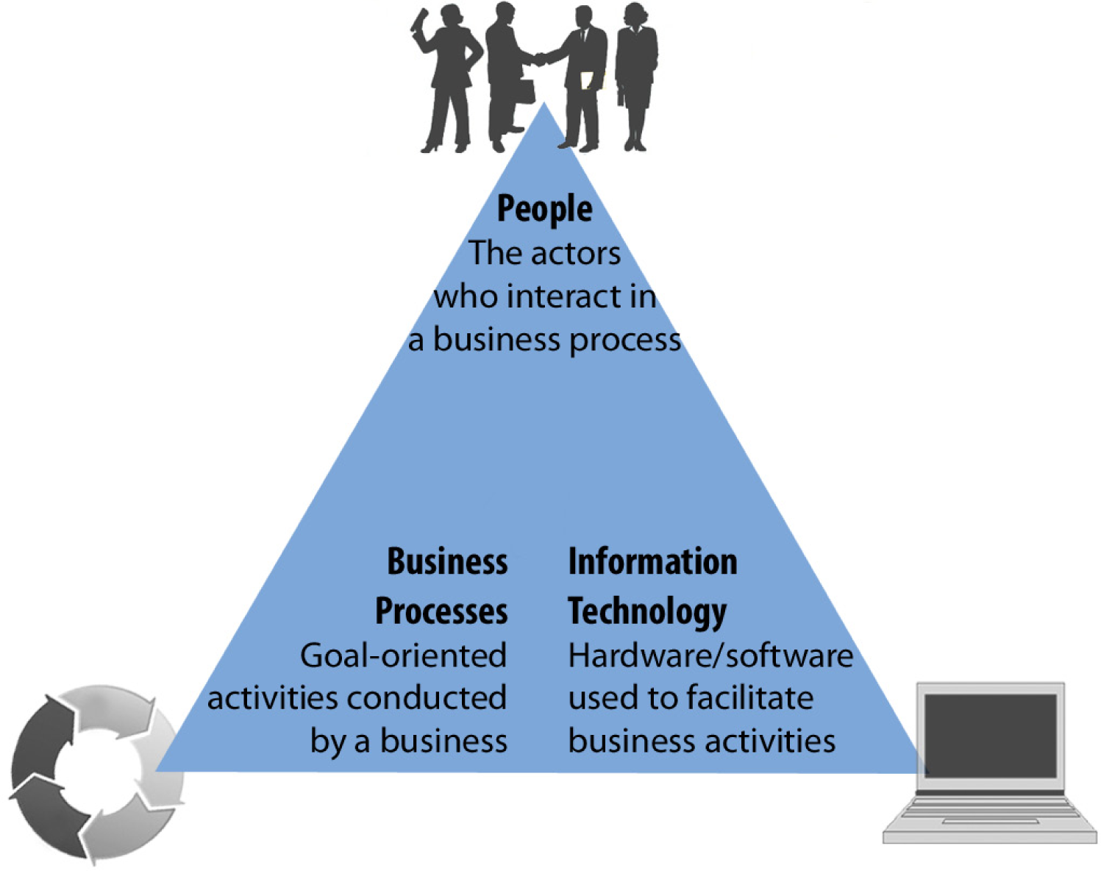
What is Information Systems?

Slide 9
Components of an Information System

Slide 10
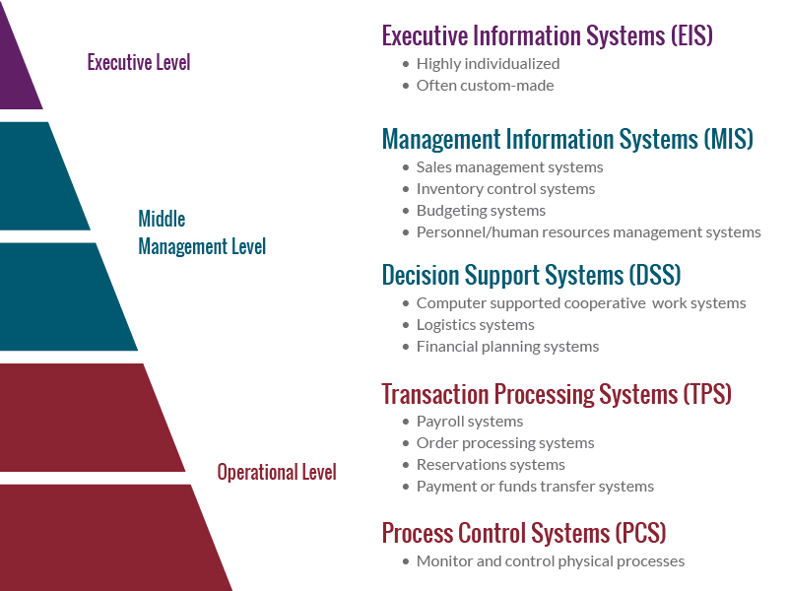
Types of Information Systems
Notes:
Example: Home Heating System (Thermostat-Controlled Heating)
Context: A home heating system maintains a comfortable indoor temperature by regulating the operation of a furnace or heater. The process control system in this case is the thermostat.
Components of the Process Control System:
Sensor:
Temperature Sensor: Located within the thermostat, it measures the current room temperature.
Controller:
Thermostat: The central unit that processes the temperature data and sends commands to the furnace or heater based on the desired setpoint temperature.
Actuator:
Furnace or Heater: The device that provides heating to the home when activated by the thermostat.
Process Workflow:
Temperature Measurement:
The temperature sensor in the thermostat continuously measures the current indoor temperature.
Temperature Comparison:
The thermostat compares the measured temperature to the desired setpoint temperature set by the homeowner.
Heating Activation:
If the measured temperature is below the setpoint, the thermostat sends a signal to the furnace or heater to turn on.
Heating Deactivation:
Once the indoor temperature reaches the setpoint, the thermostat sends a signal to the furnace or heater to turn off.

Slide 11
Prescribed reading
Pham2021
Chapter 1, Section 1.1 to 1.6
INFORMATION
SYSTEMS FOR
BUSINESS (REVISED
1ST EDITION, 2021)
Ly-Huong T. Pham, Tejal Desai-Naik, Laurie
Hammond, & Wael Abdeljabbar
ASCCC Open Educational Resources
Initiative (OERI)

Slide 12
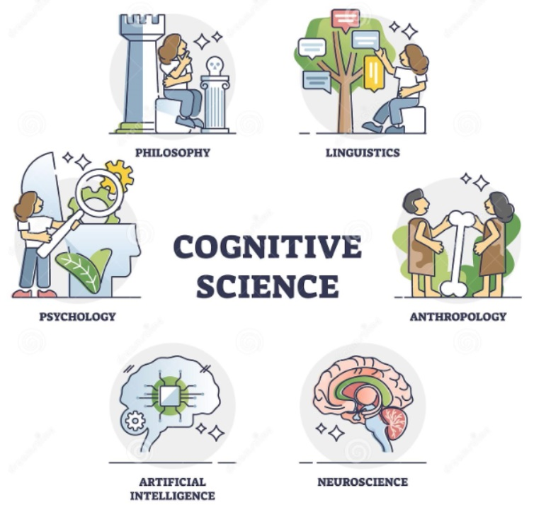
What is Cognitive Science?
Notes:
Cognitive science is the interdisciplinary study of the mind and its processes. It involves understanding how people think, learn, remember, and perceive. The field combines knowledge and methods from several disciplines, including:
Psychology: Examines mental functions and behaviours.
Computer Science: Uses computational models to understand and simulate thinking processes.
Neuroscience: Studies the brain's structure and functions to see how they relate to mental activities.
Linguistics: Looks at how language is processed and produced.
Philosophy: Explores the nature of the mind and consciousness.
Anthropology: Investigates how culture affects cognition.
The goal of cognitive science is to understand how the brain enables the mind, how different cognitive functions are interconnected, and how these processes can be replicated in machines or improved in humans.

Slide 13
What is Computer Engineering?
Notes:
Embedded Systems: Explanation and Example
What is an Embedded System?
An embedded system is a specialized computing system that performs dedicated functions or tasks as part of a larger device. Unlike general-purpose computers, embedded systems are designed to perform specific tasks, often with real-time computing constraints. They are typically embedded as part of a complete device including hardware and mechanical parts.
Key Characteristics of Embedded Systems:
Dedicated Functionality: Designed for a specific function or set of functions within a larger system.
Real-Time Operation: Often required to perform tasks within a strict time frame.
Resource Constraints: Typically have limited processing power, memory, and storage.
Reliability and Stability: Must operate continuously and reliably, often in harsh conditions.
Embedded within Larger Devices: Part of larger systems, such as cars, appliances, and industrial machines.
Example: Embedded System in a Washing Machine
Context: A modern washing machine uses an embedded system to control its various functions, such as filling water, washing, rinsing, and spinning.
Components of the Embedded System:
Microcontroller: The brain of the embedded system, programmed to manage the washing machine's operations.
Sensors:
Water Level Sensor: Measures the water level to ensure the correct amount is used.
Temperature Sensor: Monitors water temperature to ensure it matches the selected wash cycle.
Door Lock Sensor: Ensures the door is securely closed before the wash cycle starts.
Actuators:
Valves: Control the flow of water into the drum.
Motor: Drives the drum to perform washing and spinning actions.
Heater: Heats the water to the desired temperature.
User Interface:
Control Panel: Allows users to select wash cycles, set temperature, and start or stop the machine.
Process Workflow:
User Input:
The user selects a wash cycle and starts the machine using the control panel.
Water Filling:
The microcontroller receives input from the water level sensor and opens the valve to fill the drum with the appropriate amount of water.
Temperature Control:
The temperature sensor monitors the water temperature, and the microcontroller activates the heater to reach the set temperature.
Washing Cycle:
The microcontroller controls the motor to agitate the drum, ensuring the clothes are thoroughly washed.
Rinsing and Spinning:
After washing, the microcontroller activates the valves to drain the water, refills the drum with fresh water for rinsing, and then controls the motor for the spin cycle to remove excess water from the clothes.
Completion:
The washing machine completes the cycle and signals the user through the control panel.
Benefits:
Automation: Automates complex washing processes, making the machine easy to use.
Efficiency: Optimizes water and energy usage by precisely controlling each step.
Customization: Allows users to select different wash cycles for different types of laundry.
Reliability: Ensures consistent performance with minimal user intervention.
This example demonstrates how an embedded system integrates hardware and software to perform dedicated functions within a larger device, enhancing its functionality, efficiency, and user experience.

Slide 14
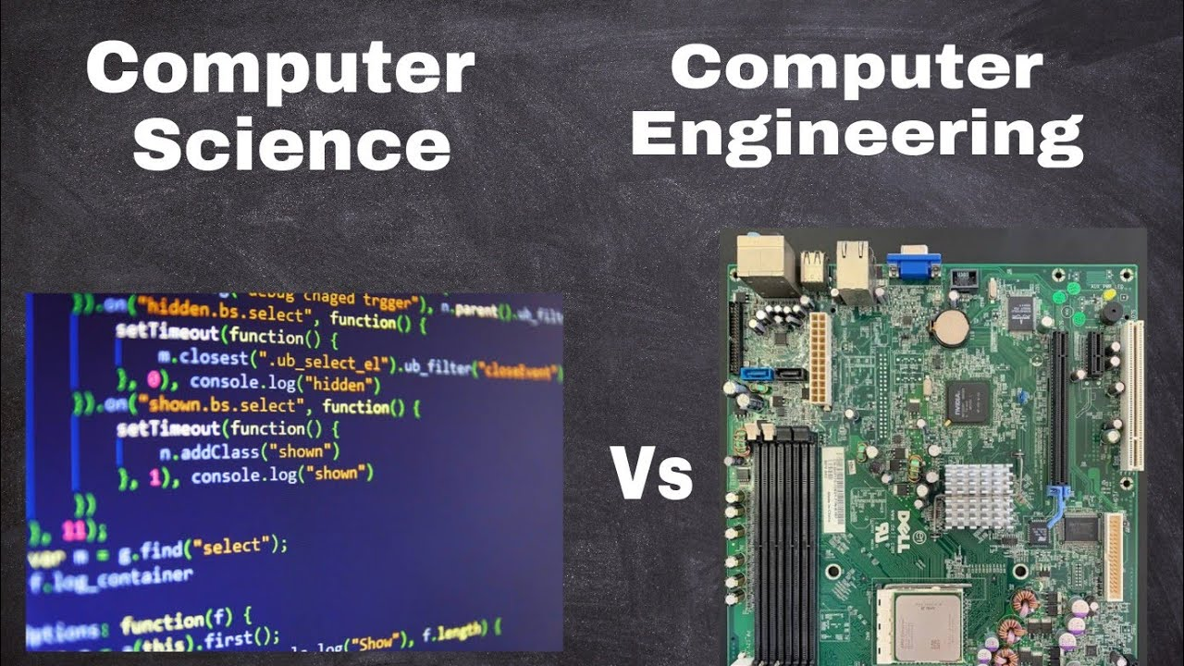

Slide 15

Mathematics and Statistics
Prescribed reading:
Truchon1997, p 1 – 53, 104 – 113
Coding is a field that involves problem-solving, logic, and creativity, but what about math?
Coding can be categorized as follows:
Procedural Languages: C++, C, Java, Python
Scripting Languages: HTML, CSS, JavaScript, Node.js, PHP, Ruby, Bash
Database Programming: SQL
Logic Programming: Data Analysis, Machine Learning, Artificial Intelligence
https://www.geeksforgeeks.org/how-much-math-is-required-for-coding/

Slide 16
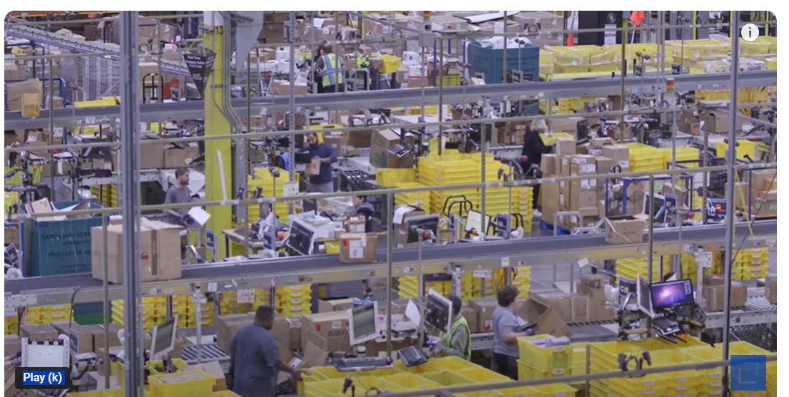
Inside Amazon’s largest warehouse
https://www.youtube.com/watch?v=_AthU0fgtCQ
8:46 minutes
Make a note of all the different technology that is used by Amazon in their warehouse

